Slide 1
AWS Serverless
Rob Koch and Matthew Bonig

Slide 2
Outline
Who We Are
Cars and Servers – 15 minutes
Common components of AWS Serverless – 15 minutes
Workflow example – 15 minutes
Q&A – 10 minutes
Notes:
This will likely be removed.

Slide 3
Rob Koch

Slide 4
Matthew Bonig
Professional Developer 10+ years
Enterprise/SMB application architect
Node/Angular (recovering .NET)
AWS Certified Solutions Architect

Slide 5
Cars
Notes:
I’ve always liked cars. As a kid I had Lamborghini posters on my wall and loved the Transformers.
When I started thinking about Serverless and why it’s so popular I saw some parallels with the way auto manufacturing has progressed over the years.

Slide 6
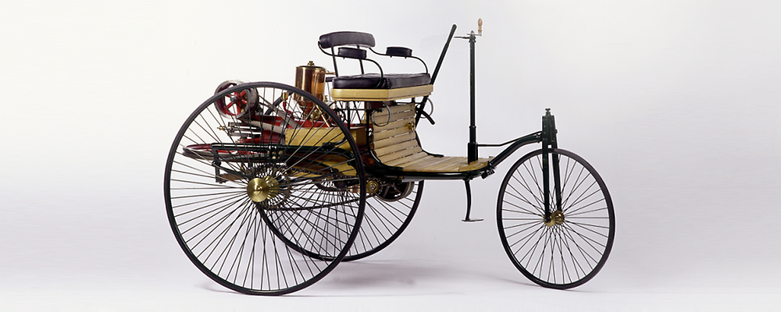
Early Cars – The beginnings
Notes:
In the beginning, there was the Benz Patent Motor Car.
Early days, everything was bespoke. Any parts not created by the manufacturer directly probably weren’t being used elsewhere.
Karl Benz

Slide 7
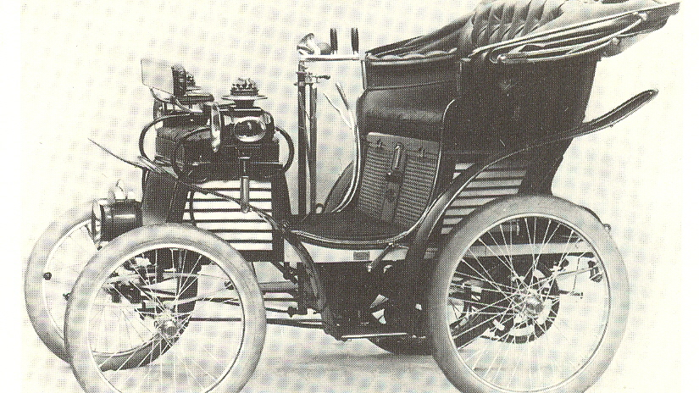
Early Cars – A little more advanced
Notes:
Steering handle changes, everything encased. 4 wheels adding lots of stability

Slide 8
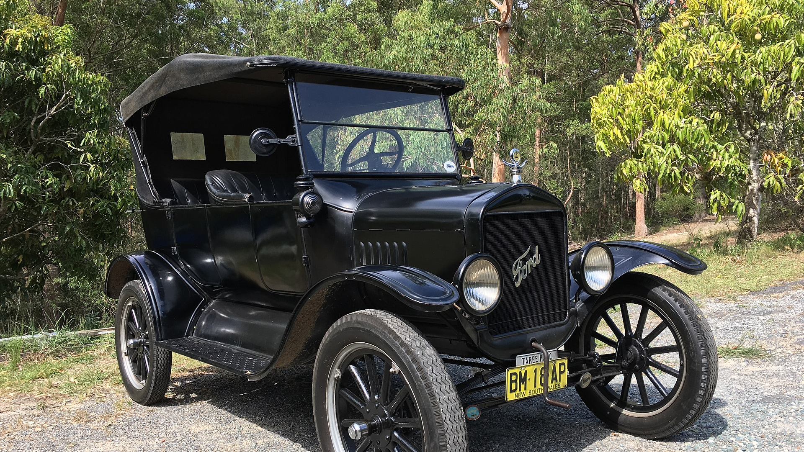
Mass production
Notes:
Ford forever changes auto manufacturing by introduce the production line, allowing for the rapid creation and iteration of the automobile.
Faster iteration resulted in spending less time R&D on common components, once it had been tested and tried through a large enough number of uses, engineers felt comfortable take parts “off the shelf”

Slide 9
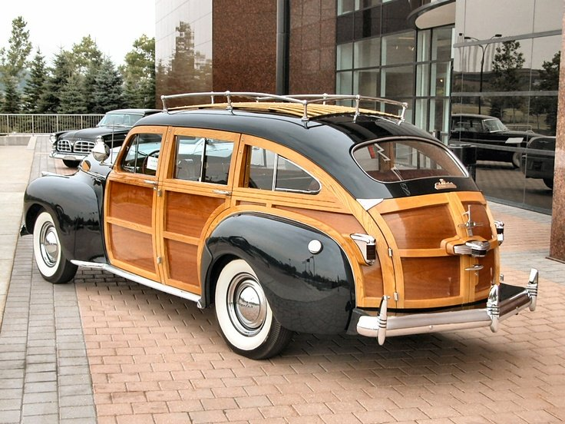
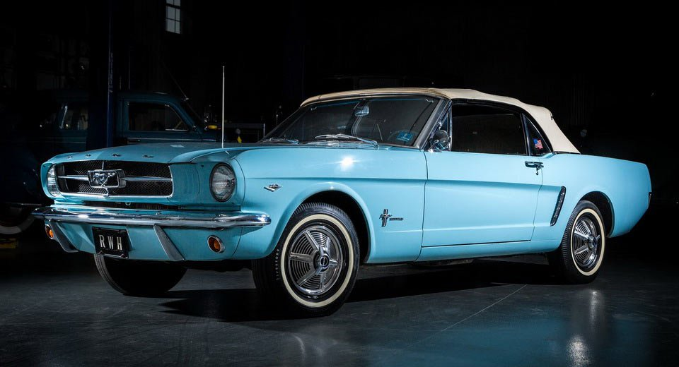
Mass production
Notes:
Awesome wagon and muscle cars!

Slide 10
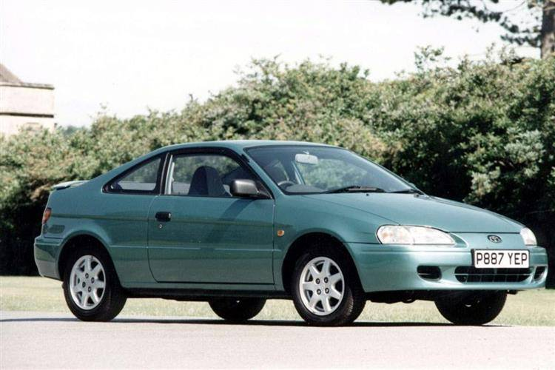
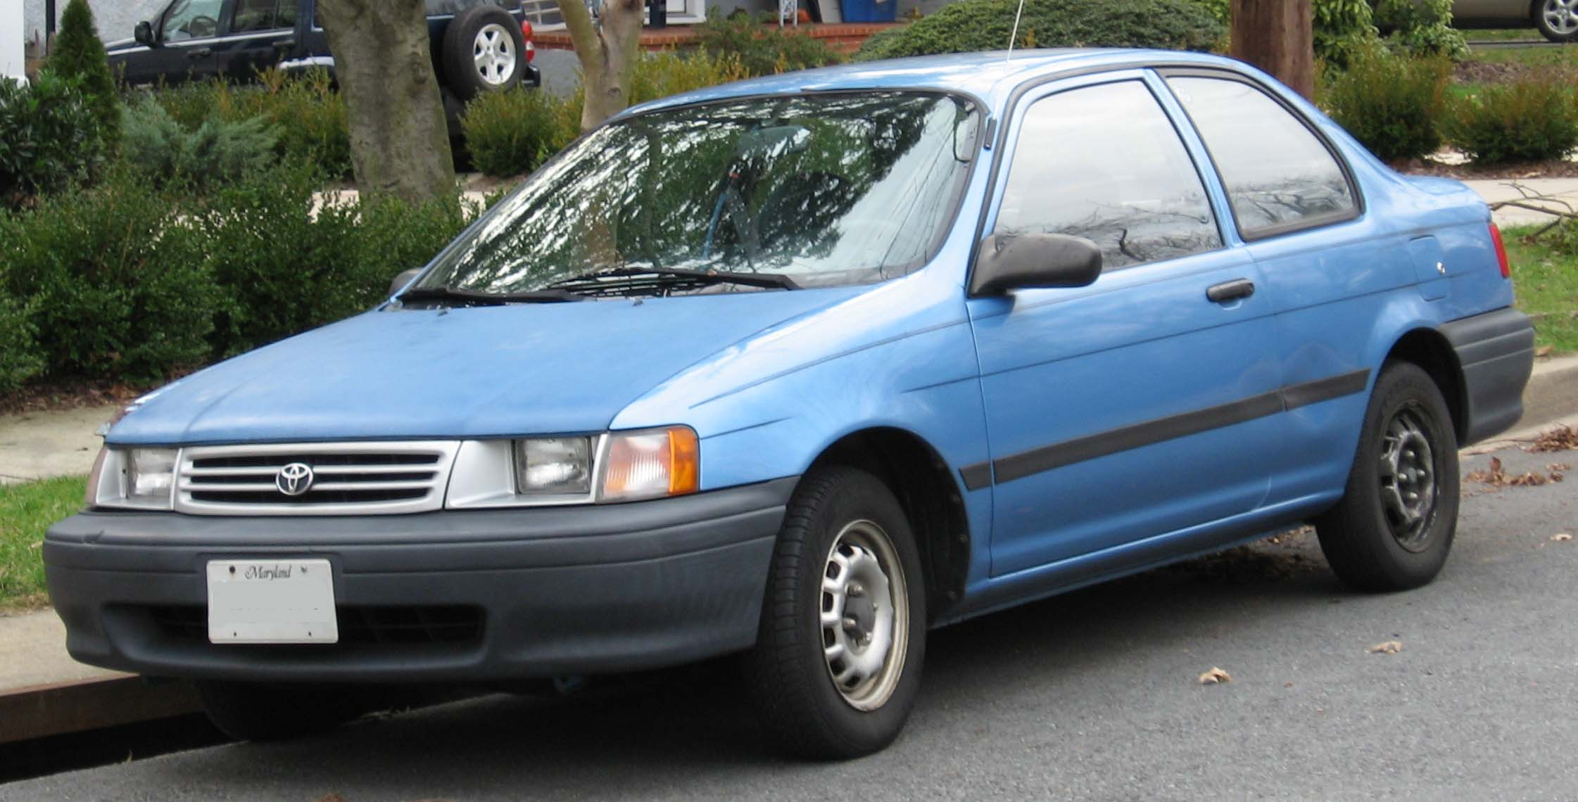
Commoditize
$11,498
$7,848
Notes:
It was easy for manufacturers to continue to rely on common designs and components for less superficial parts of the cars. They focused on what they wanted THAT car to be in the market.
Twinning starts to become common, the reuse of nearly the entire car. This would occur across models under the same manufacturer (Toyota Tercel and Pinto-thing). Sometimes even across brands (Toyota and lexus) and corporations (Toyota and Subaru).
Emails, then

Slide 11
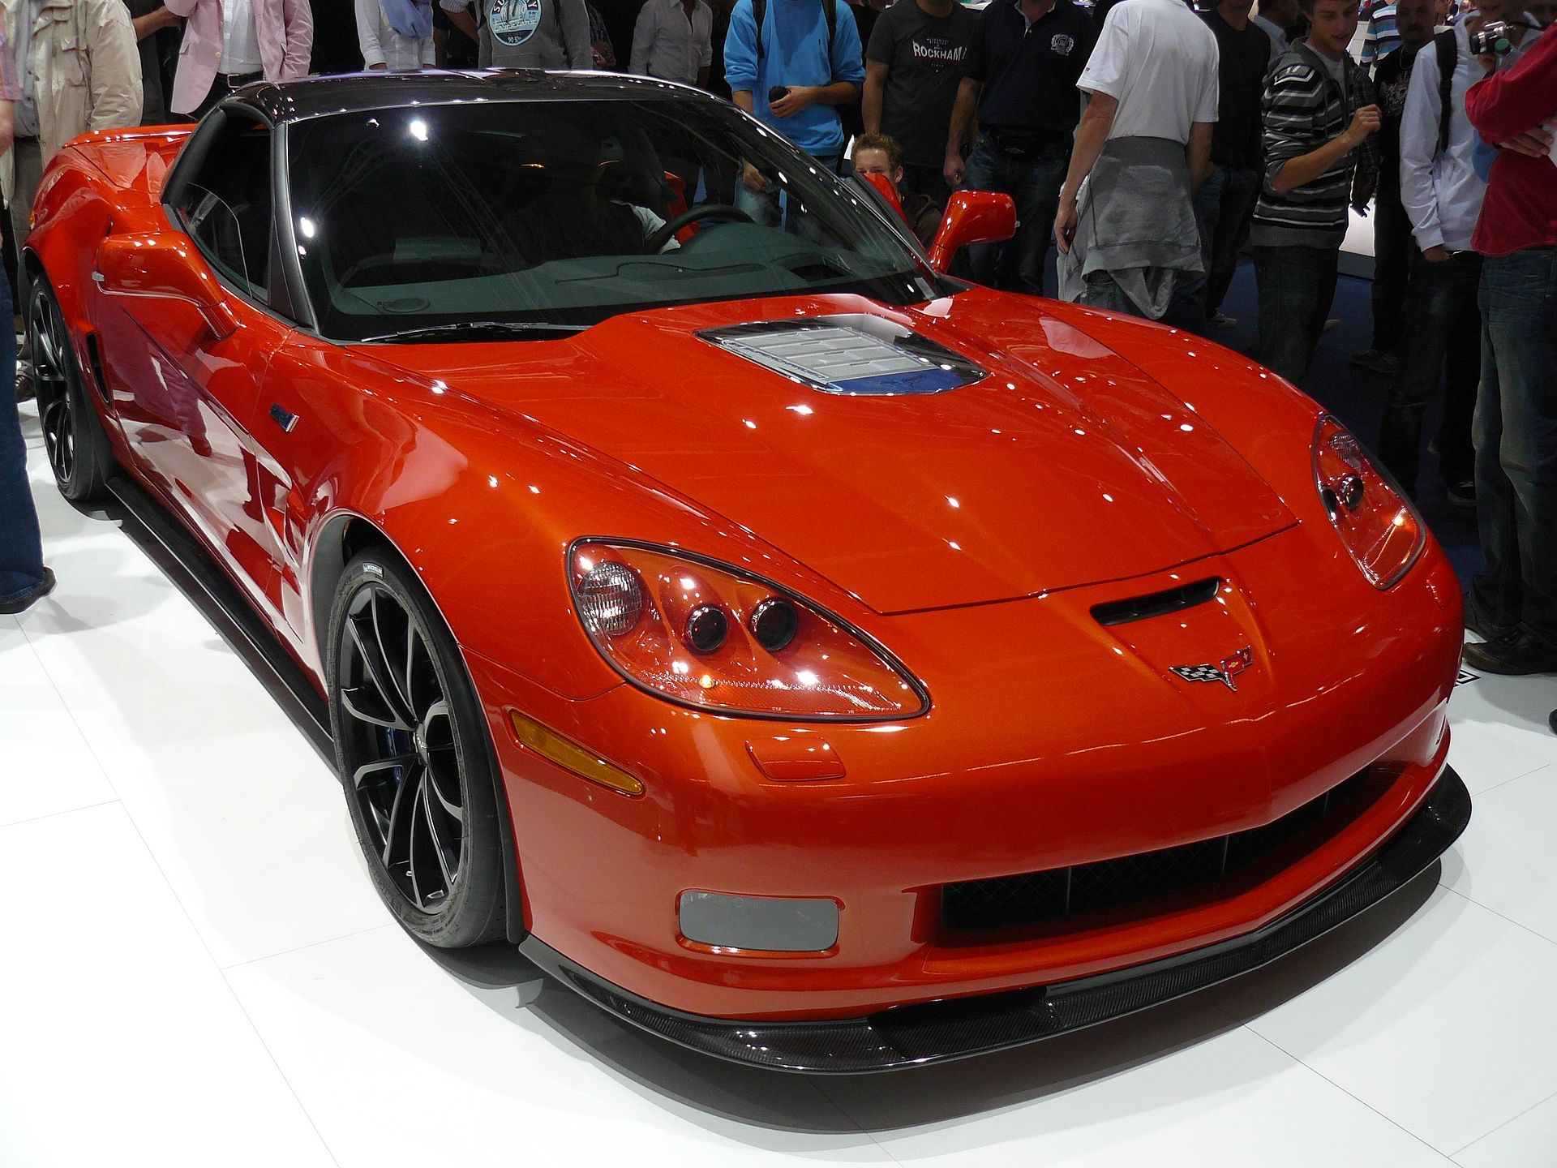
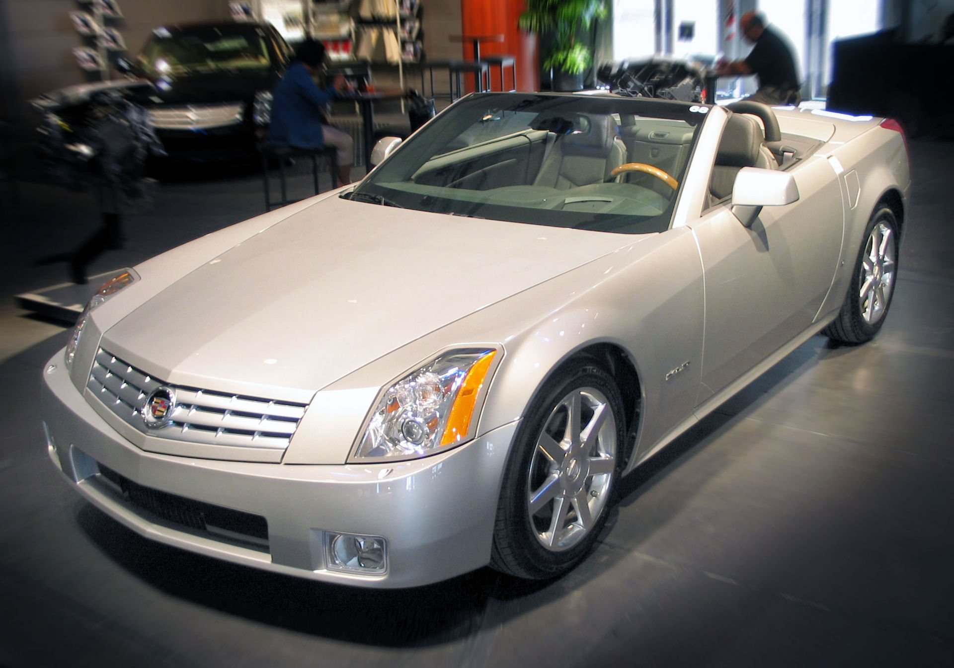
Commoditize
Notes:
Now all major auto makers have common platforms across their cars.
Michigan or California?

Slide 12
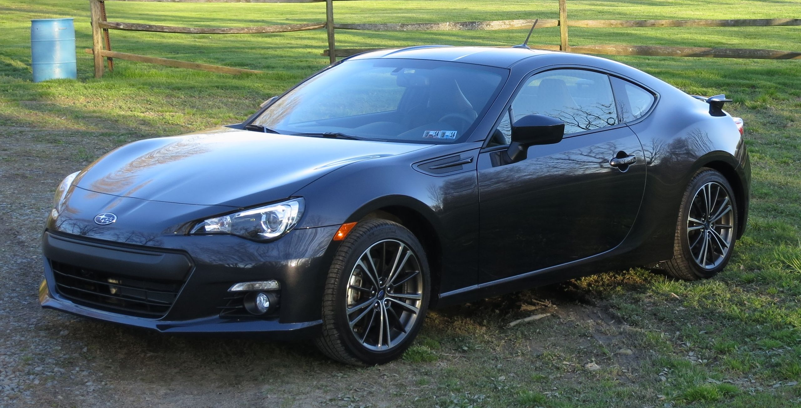
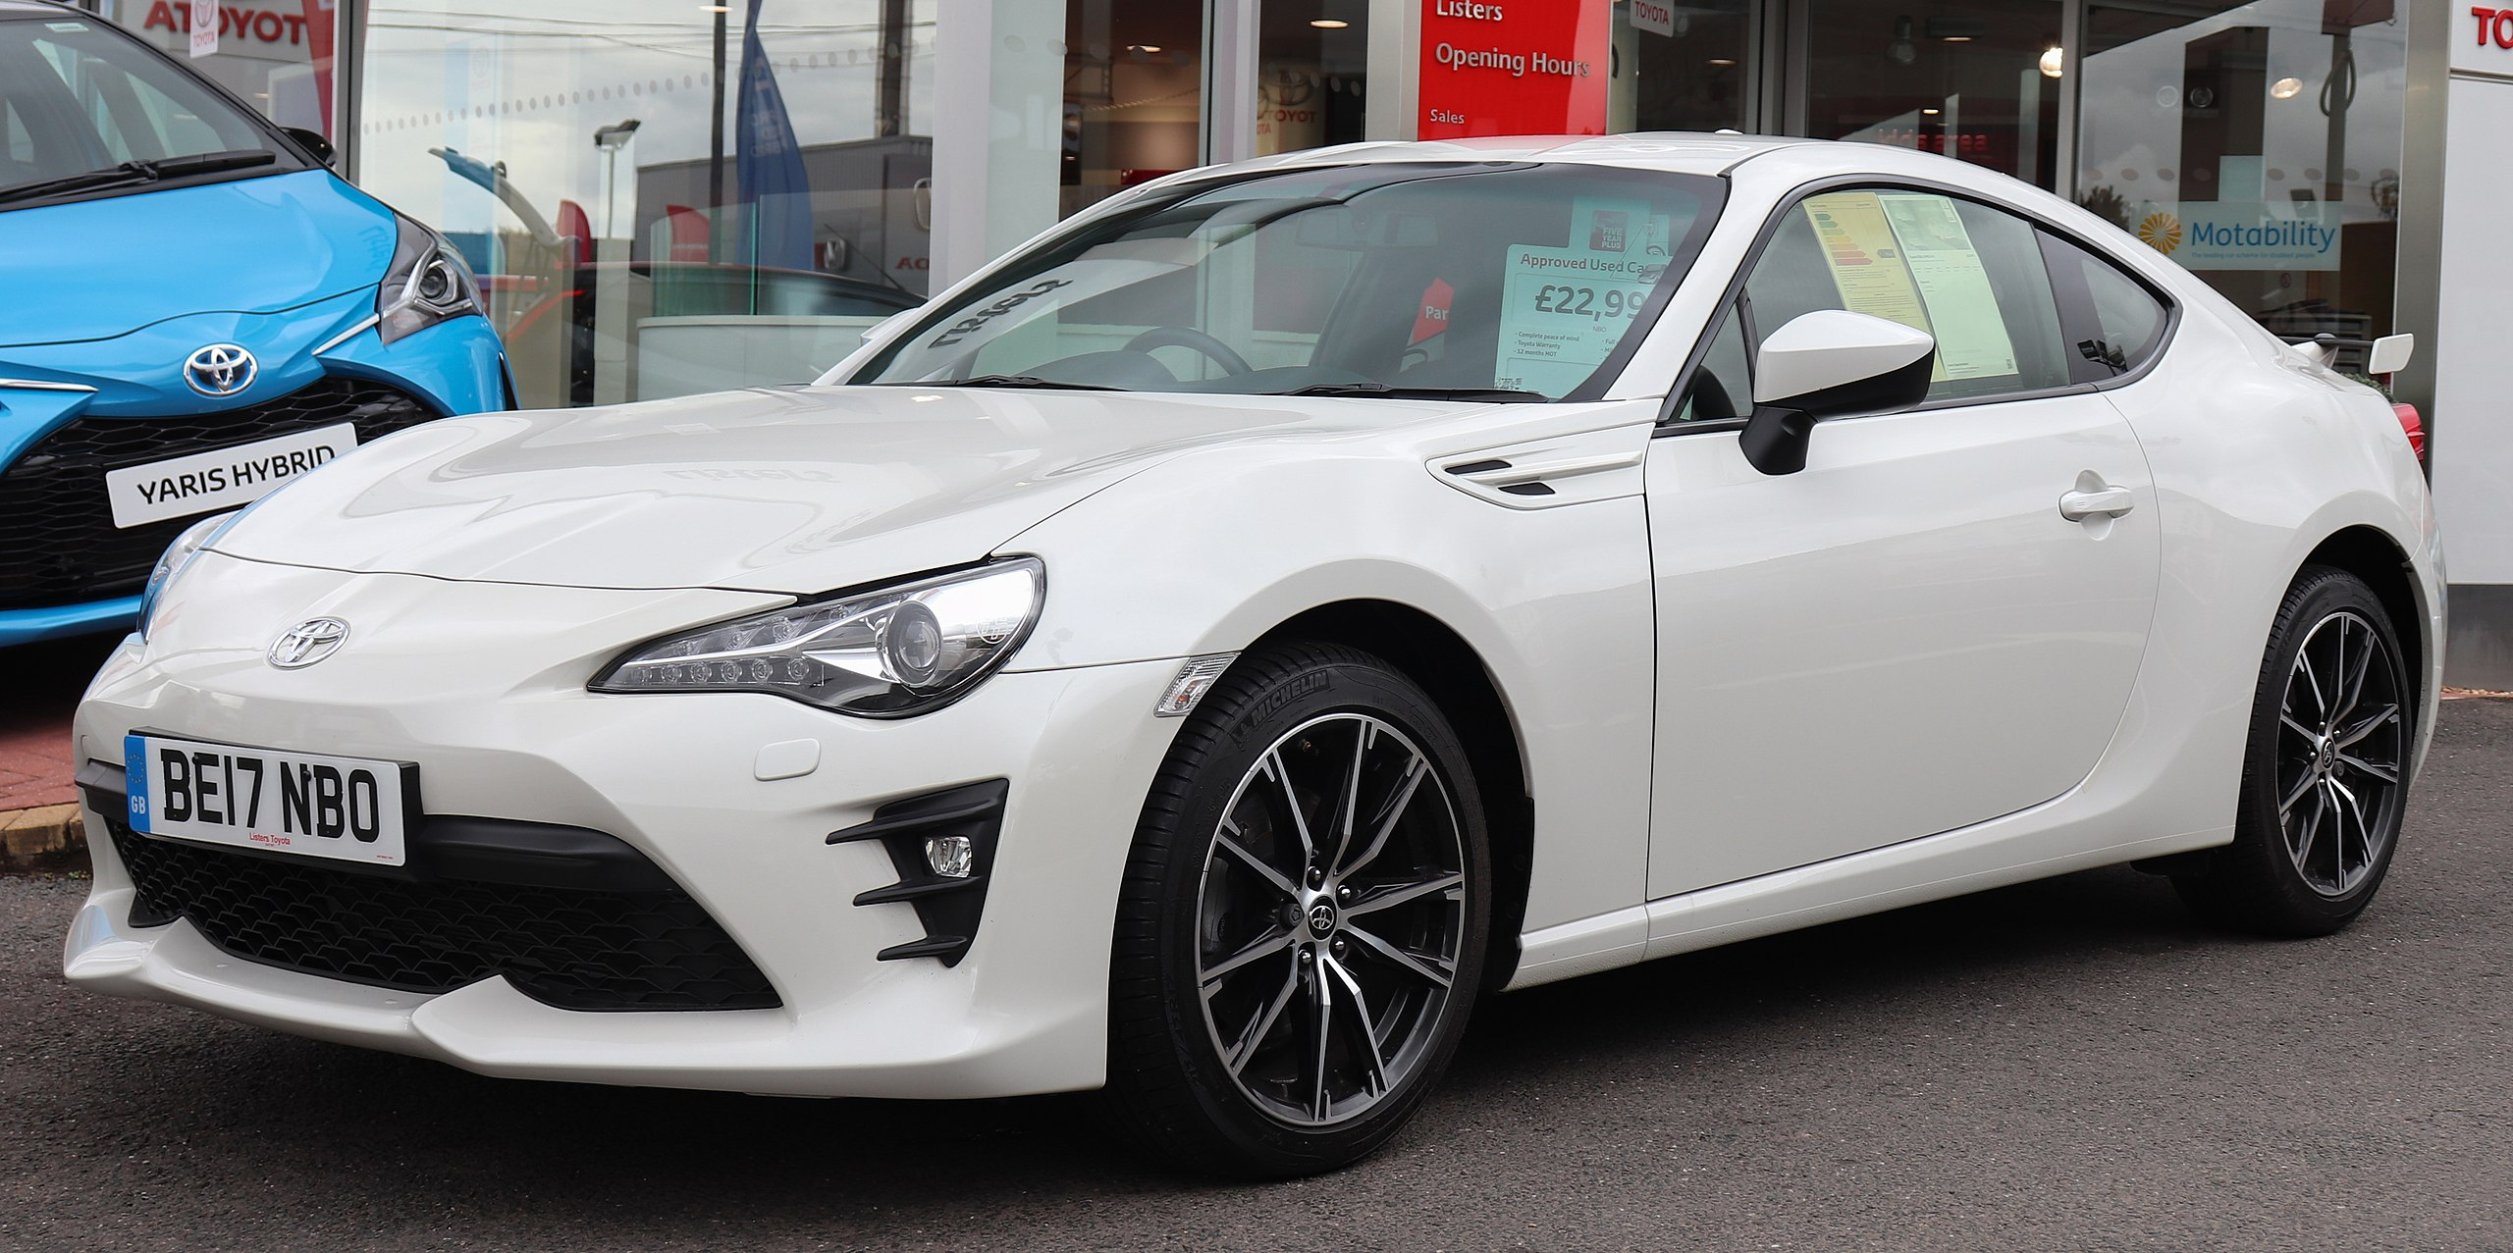
Commoditize
Notes:
Toyota or Subaru?

Slide 13
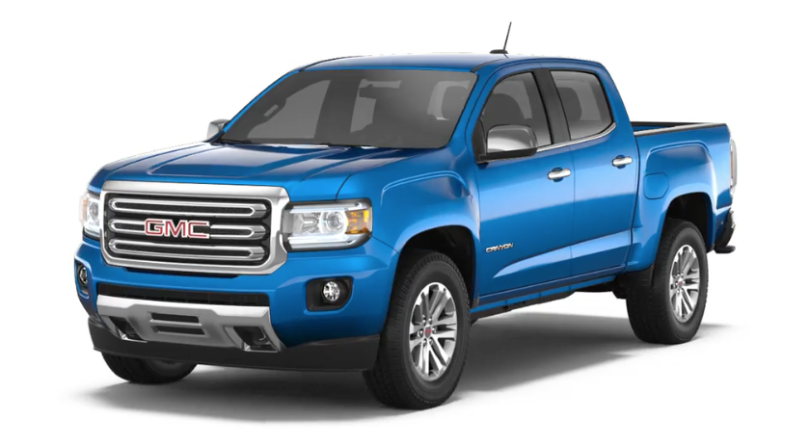
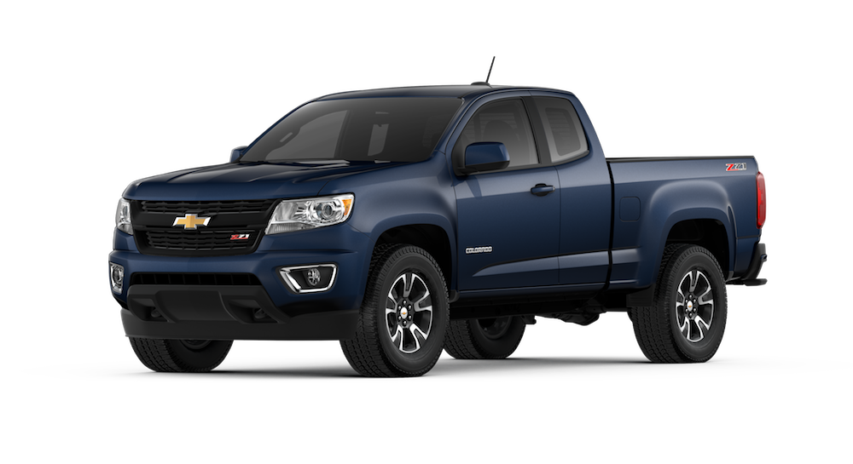
Commoditize
Notes:
GMC Canyon and Chevy Colorado
$2k difference base starting price, Chevy sells 4x as many last year

Slide 14
Specialization
Chevrolet Colorado Sales Numbers
Sales Results - USA - Colorado
Year | Jan | Feb | Mar | Apr | May | Jun | Jul | Aug | Sep | Oct | Nov | Dec | Total
2019 | 11,165 | 11,165 | 11,165 |  |  |  |  |  |  |  |  |  | 33,494
2018 | 8,011 | 8,050 | 12,798 | 13,672 | 13,672 | 13,672 | 11,654 | 11,654 | 11,654 | 10,001 | 10,001 | 10,001 | 134,842
$38,095
GMC Canyon Sales Numbers
Sales Results - USA - Canyon
Year | Jan | Feb | Mar | Apr | May | Jun | Jul | Aug | Sep | Oct | Nov | Dec | Total
2019 | 2,318 | 2,318 | 2,318 |  |  |  |  |  |  |  |  |  | 6,954
2018 | 2,171 | 2,319 | 2,723 | 3,212 | 3,212 | 3,211 | 2,808 | 2,808 | 2,808 | 2,740 | 2,740 | 2,740 | 33,492
$40,395
+ ~6%
Notes:
By cutting R&D costs to only superficial components (styling and interior) we see a highly specialized industry right now.
GMC Canyon and Chevy Colorado. Nearly identical.

Slide 15
Beginning to Highly Commoditized
1885 to 2015

Slide 16
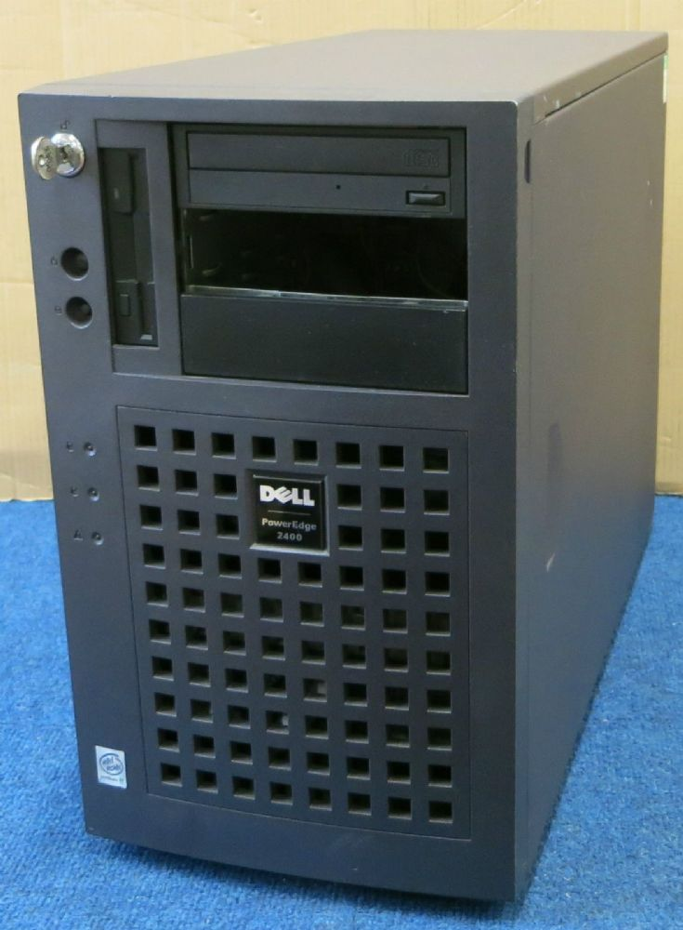
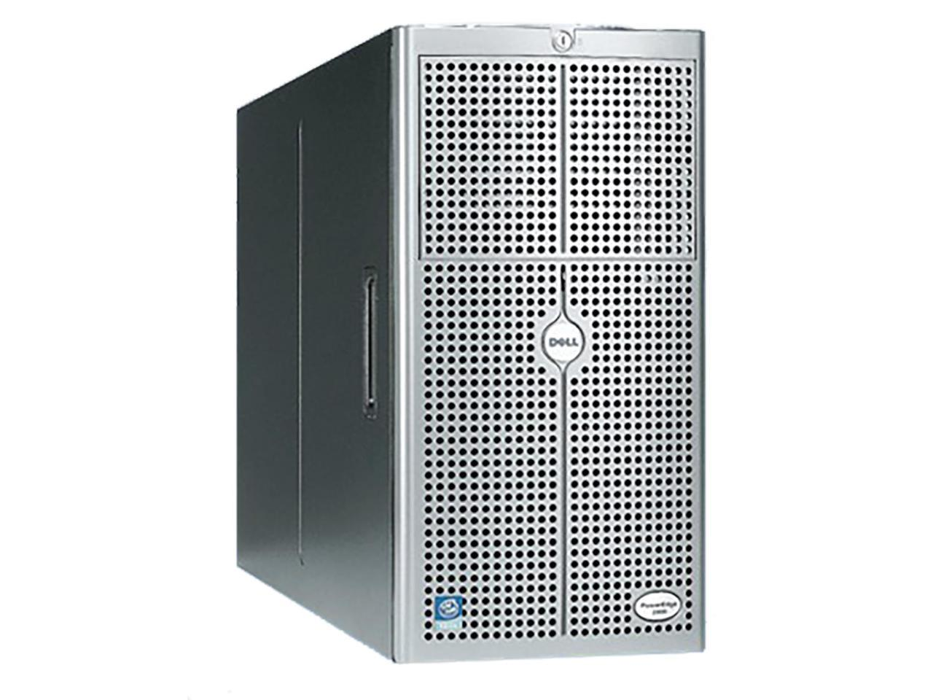
Software Systems – The Beginning
Notes:
Still bespoke. Very slow. Need a new system? Order it, wait days, put it on the network. Install software. If you’re lucky it’s a week.

Slide 17
Mass Production
Notes:
We turned physical hardware into virtual software.
Need a new system? 10 minutes.

Slide 18
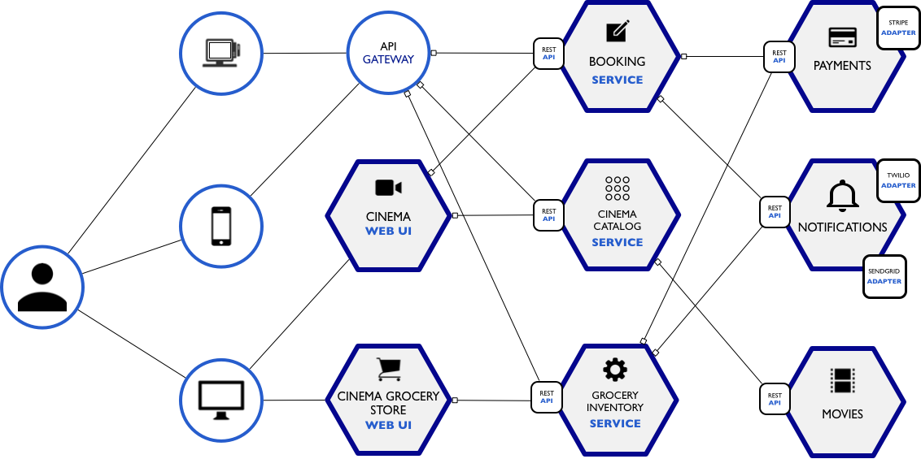
Service Oriented Architectures
Notes:
Your standard web application architecture is the Chevy Colorado of software systems. Everyone’s got one, they don’t vary too much. Container or AMI is your web tier, db is a service, sqs (pub sub) is a service, email is a service, everything is a service. Container/web server is your engine, transmission is your database. Email is your wheels, scalability is your frame.
Virtual machines with base images (EC2 with AMIs)
Service oriented architectures became dominant
Everything is a service

Slide 19
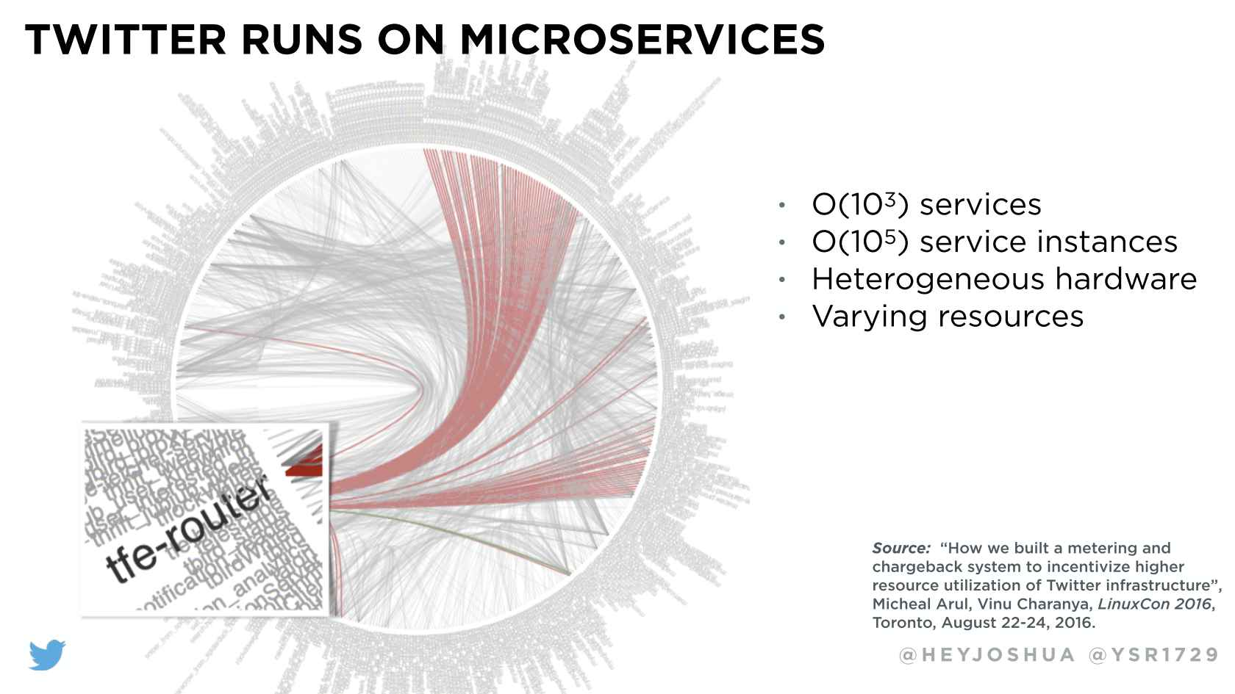

Slide 20
Serverless
The Service Oriented Architecture (SOA) has evolved to allow significant amounts of the traditional application code to be delegated to easily consumed managed services.
As the auto manufacturer now spends little on R&D for common components like shocks, brakes, frame designs, etc., Serverless allows system architects to leverage well designed and managed dbs, api endpoint services, worker processes, etc., reducing R&D and increasing TTM while reducing TCO.

Slide 21
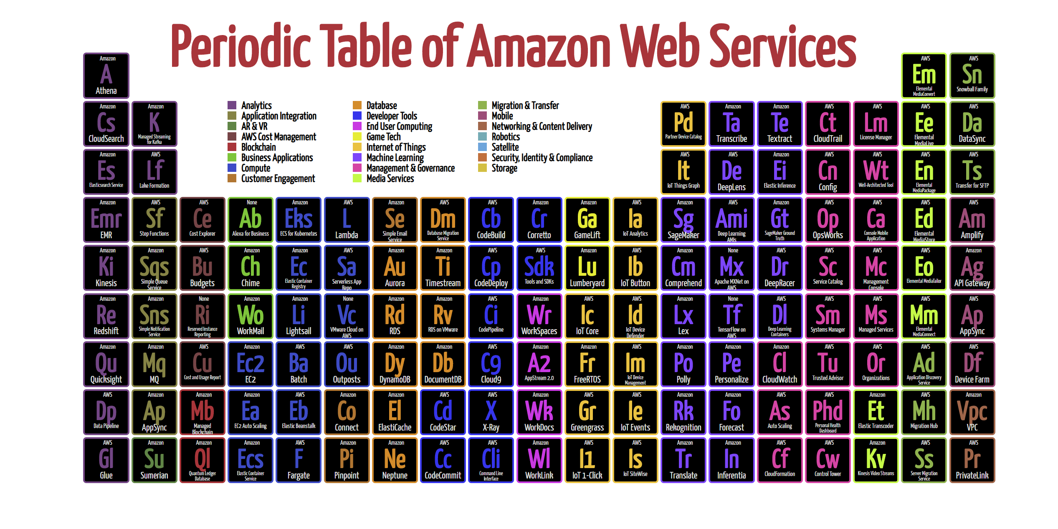

Slide 22

Lambda

Slide 23
Compute layer, helps with business-specific rules
Commoditized programming
One stop shop for mobile, 3rd party, web, IoT
Security via IAM or in logic
Triggered by events or scheduled via CloudWatch

Slide 24
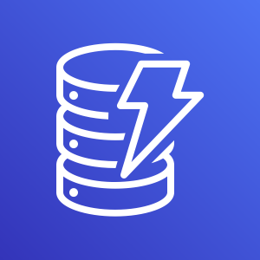
DynamoDB

Slide 25

S3

Slide 26
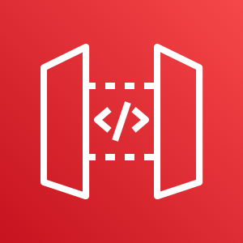
API Gateway

Slide 27

Cognito

Slide 28

X-Ray

Slide 29
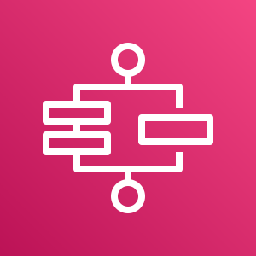
Step Functions

Slide 30
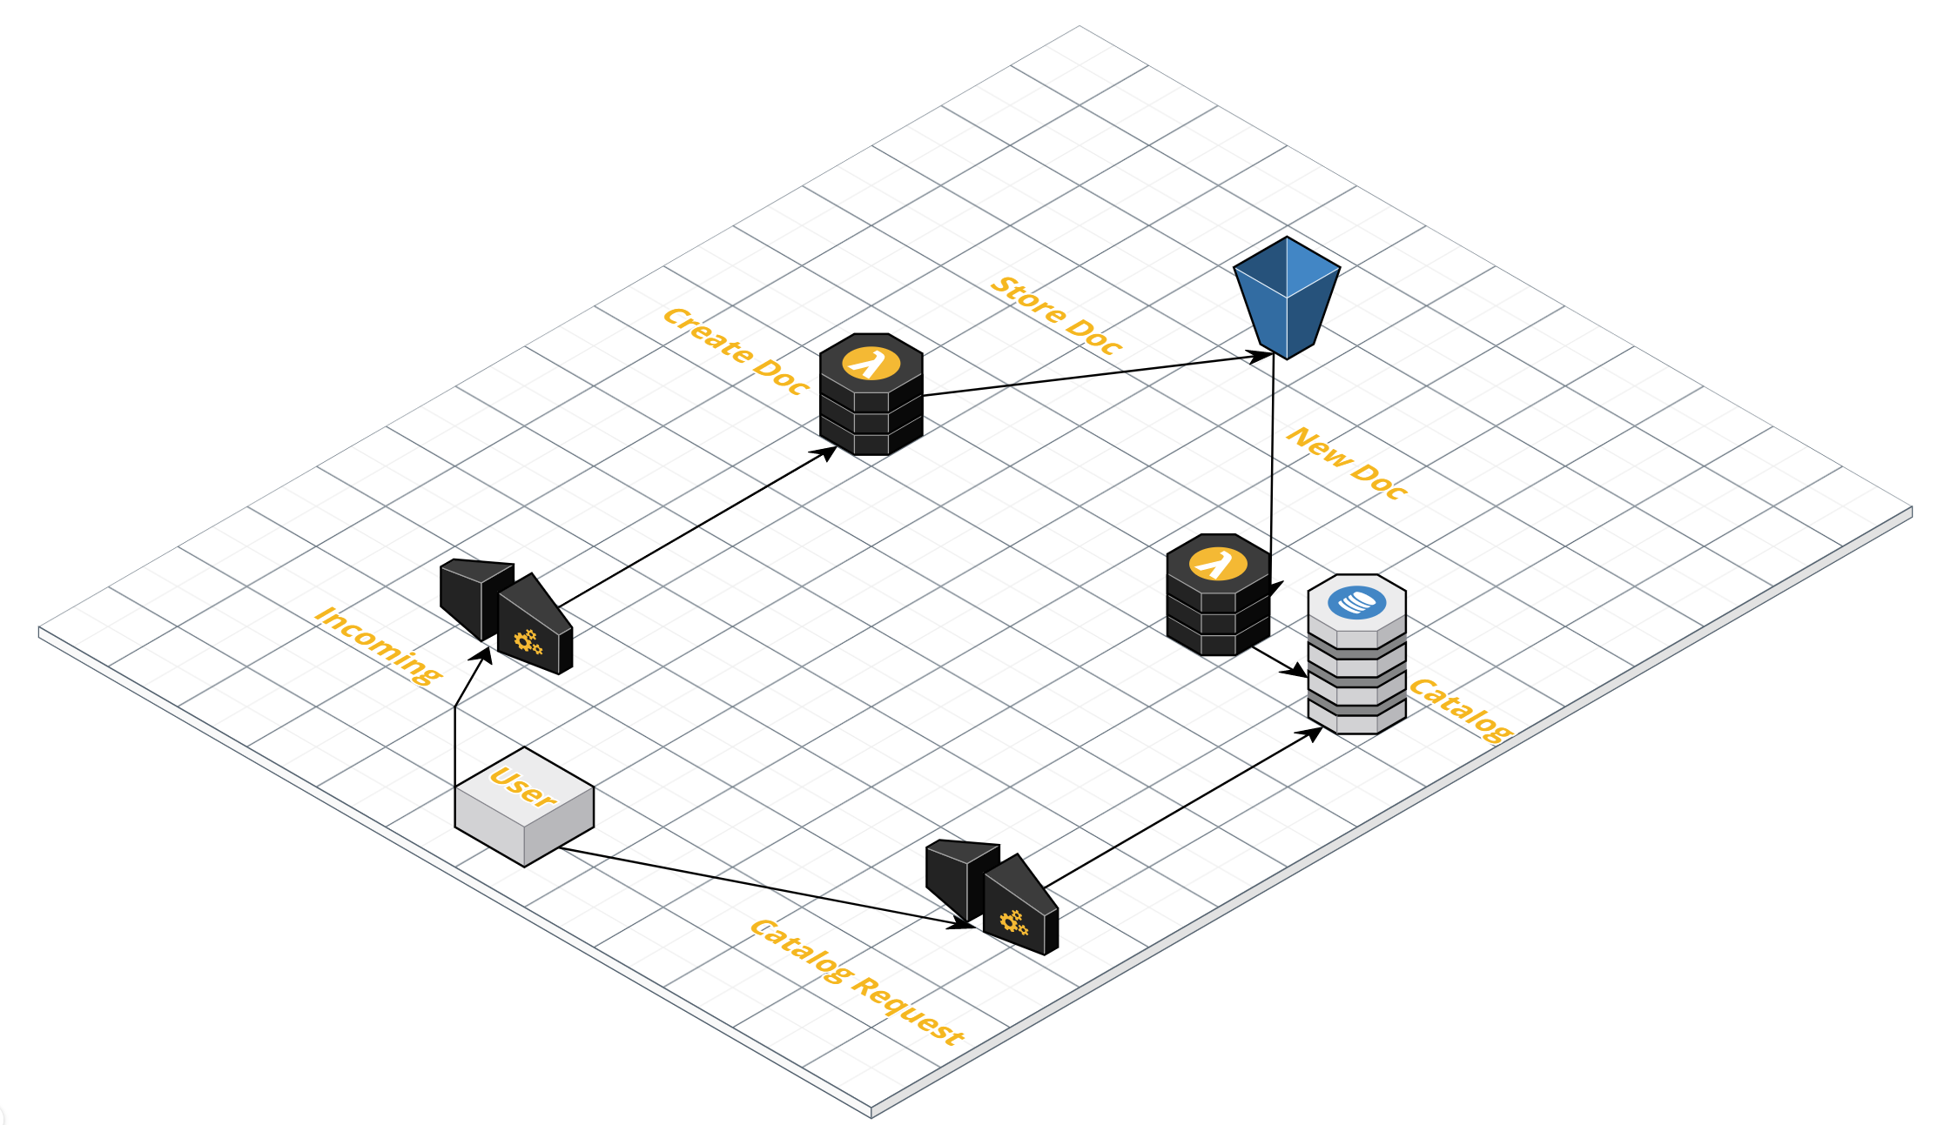
Demo Time!

Slide 31
Going Deeper

Slide 32
Q&A

